Slide 1

Modern Control Theory
Lecture No. 5
The Big Picture --- Concept of a Pole in State Space Model
The Pole Placement Problem
The Concept of Controllability
State Transfer

Slide 2
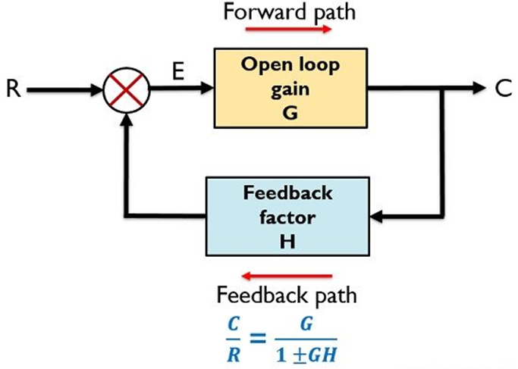
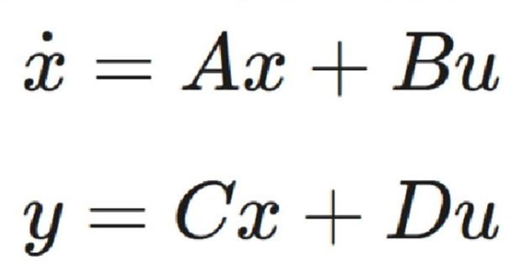







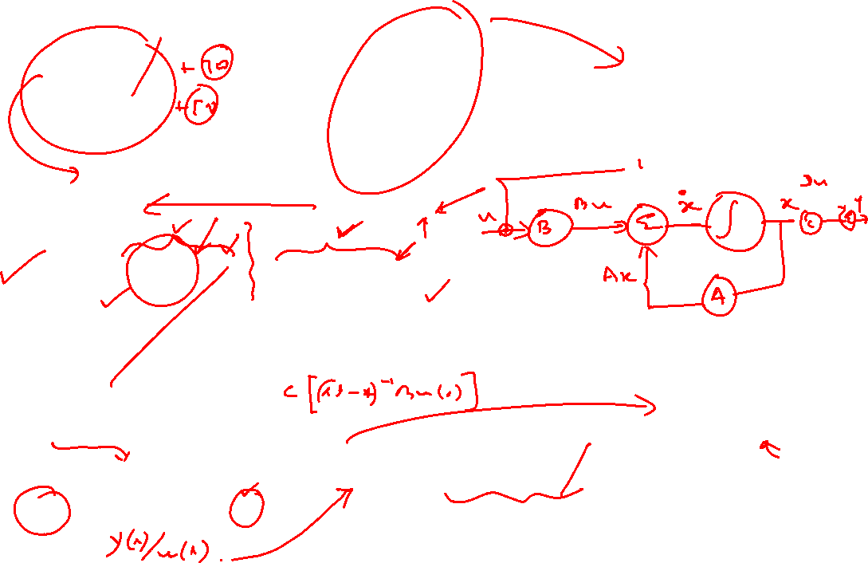
Concept of a Pole/Eigenvalue
Zero-Input Component of the State Vector
Zero-State Component of the State Vector

Slide 3

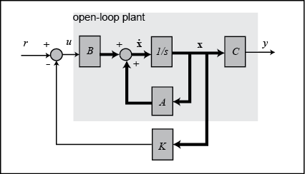
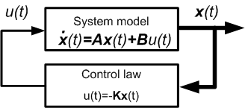



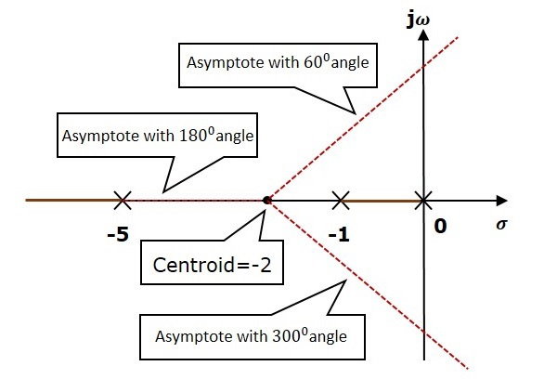

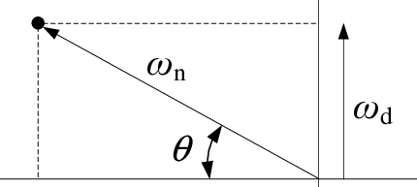
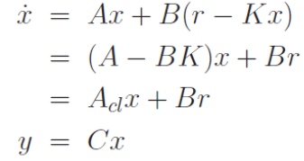


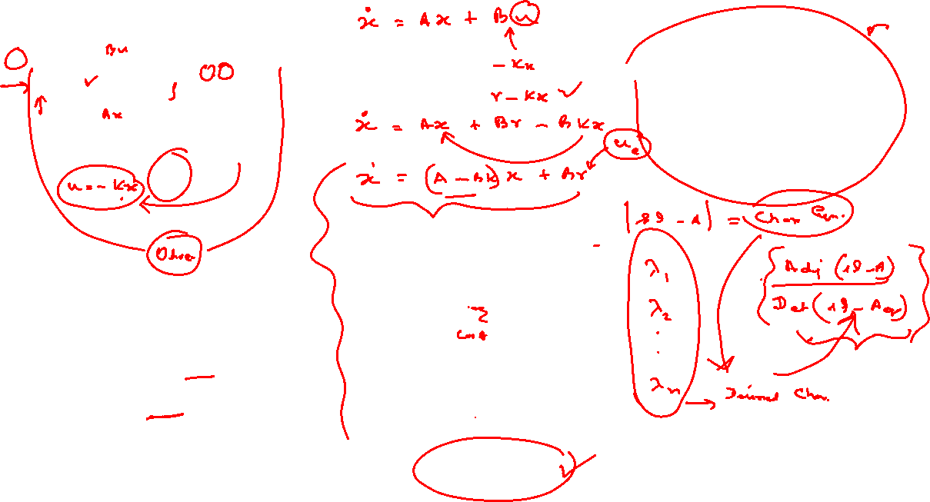

Concept of Pole/Eigenvalue Placement

Slide 4
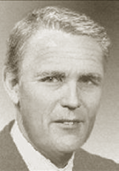
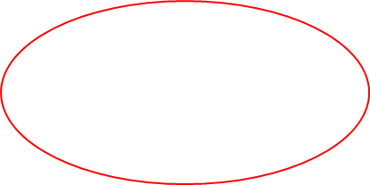
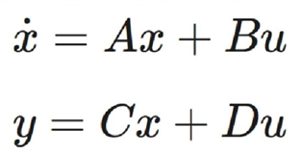
The Concept of State Transfer
Input Space
U
Observation
Space
Y
State Space
X(1)
State Transfer
X(0)
Time Driven

Slide 5





Review ---- Discretizing the State Equation

Slide 6




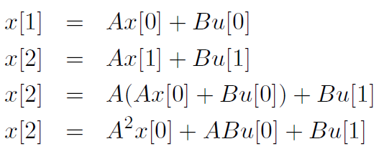





Concept of Controllability

